Slide 1
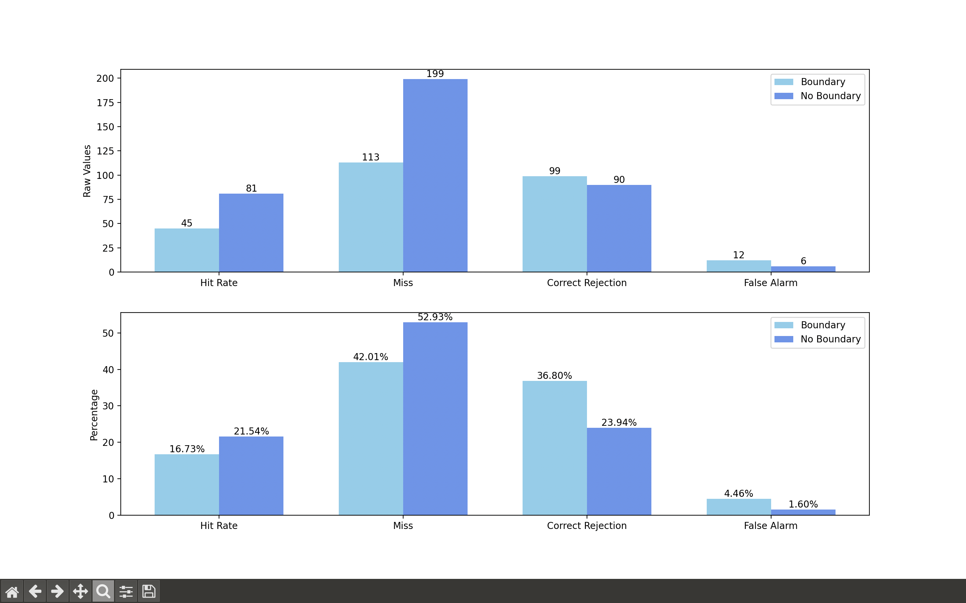
Condition 'At boundary'
visual_cue 0 1
loc_change
0 108 111
1 146 158
Condition 'No boundary':
visual_cue 0 1
loc_change
0 9341 96
1 146 280

Slide 2
